Slide 1
DSU Society election guide
Understanding elections and how to tailor them to your Society’s needs
By Tammy Maniou, DSU VPI 2022-2024

Slide 2
What are Society elections?
Elections are the main method of appointing people in a Society’s leadership.
Society elections are governed by the DSU Society Policy (SP for short) and (if applicable) your Society’s constitution.
Society elections are an opportunity for the Society’s membership to have a say in how the Society is run.

Slide 3
Appointments vs Elections
What is the difference?
Elections are membership-driven and done for most positions on executive.
Appointments usually come after elections, as they are decided on by one or more people on the Society’s leadership.
Appointments can restrict eligibility for the position, whereas elected positions are and should be open to all members (SP 11.4), except for representative positions (SP 11.4.1).
Why would you choose to appoint a position, not elect?
The position has a particular set of skills or background that is needed to be done properly.
Ex.: finance position. Students with a background in finances, econ, business, etc., have a greater chance of doing the job well than someone who is completely new to the role.
The position may not have as many responsibilities as the main ones or is overseen by another position.
E.g.: Staff positions, assistants, commissioners; positions that may or may not be paid but whose selection would benefit from an interview/application process to assess compatibility with the supervisor and with the role and setting.

Slide 4
Stages of an election process
Prep work
1
Nominations
2
Campaigning
3
Voting
4
Transition
5

Slide 5
Prep work: Creating candidates
Throughout your time in a leadership position, you will have noticed your members’ strengths and weaknesses, and should have allowed them to prove their ability to become good candidates for executive positions.
Based on those observations, you can talk to your membership about potentially running in the elections and which positions would suit them. Sometimes people need someone to believe in them to take a chance!
Note that this is not the same as favouritism; you should not treat people preferentially or give them unequal opportunities, support, and info. But you do need to ensure your Society will have a bright future ahead, and that can only be done by cultivating your membership’s skills and confidence.

Slide 6
Scenario: Creating candidates
Scenario 1: Leadership
Sally and Mike are committed members of the Unicorn Conservation Society (UCS). You are the President. They volunteer at events, spend time with other members, and care about unicorns. This makes them good future UCS leadership.
Sally is boisterous and excitable; qualities appealing to humans, but unicorns are afraid of her. She would be suitable for a social relations position. You create a shadowing program with the current Manager that members, Sally included, can participate in. You encourage her to participate. Sally finds the experience fulfilling. She runs for the position.
Mike is shy and conflict avoidant, which makes people feel like he can be unhelpful at times. But Mike is a biology student and knows how to treat animals. So, you put together a workshop series about how to be a good unicorn caretaker, where members including Mike can be trained. You encourage him to participate. This opportunity calms his nerves, and he now believes he is qualified for the position, so he applies.
Because of your leadership, Mike and Sally decide to run for Unicorn Caretaker and Social Relations Manager, respectively. They each have two opponents, and Mike wins while Sally loses. Sally decides to join the team as the Social Media Coordinator under the new Manager, and together they create fundraising campaigns that raise money for quality clove seeds (unicorns love cloves), which make Mike’s work easier.
Scenario 2: Favouritism
Your friend Sammy is a casual member of UCS. They’re not really interested in unicorns, but they like hanging out with you and the others. You think Sammy should become the President of UCS, so you tell them everything about your role and how it works. You only focus on Sammy, though, and other people notice.
During elections, Sammy is running unopposed. They win, but no one really trusts they’re qualified. Next semester, Sally and Mike do not return. When you ask why, Sally says she doesn’t like Sammy’s lack of vision for the role, and Mike says your preference towards Sammy made him feel invisible, so he decided to focus on his studies instead.

Slide 7
Prep work: Logistics
Decide on the format and rules for your election.
Consult appropriate governing documents.
Consider which procedures allow for the most transparency and accessibility.
Things to consider are:
In-person vs online voting
Campaign rules
Proxies
Rule enforcement procedures
Timelines
Appoint an Elections Officer.
The EO is the person overseeing the elections, answering questions about them, and is responsible for monitoring candidates and enforcing the rules.
The EO must be someone not running in the elections at the same time (SP 11.3).
Set up necessary things ahead of time.
Notice for elections needs to be given to members at least two weeks in advance of the close of nominations (SP 11.5).
Provide notice to the membership.
This includes but is not limited to:
“Notice must include information about the positions available and instructions on how to run in the elections” (SP 11.5).
In person voting:
Room bookings
Ballots
Online voting:
Nomination form
Voting form
Update mailing list (remove former members, add new)
Any necessary training for candidates (e.g., anti-oppression training).

Slide 8
Prep work: Membership definition
Why is defining your Society’s membership important?
It allows those who are a part of the Society, contributing to ideas/activities, represented by your Society, to have a voice.
It prevents influence from outside parties (aka non-members).
Distribution of election materials is limited to only people within the Society, preventing frustration and mistrust in the democratic process.
How is Society membership defined?
Society membership is something decided on internally, based on Society type, and based on your Constitution (which is recommended to have especially for those types of occasions).
Breakdown by type:
Levy Societies: All Dalhousie students (and King’s, if applicable). Ex.: Dal Bike Centre. Opt-outs may apply.
Faculty Societies: All students within your Faculty (e.g., Science, Management, etc.).
Residence Councils: All students living in your Residence (e.g., Howe Hall Council, Gerard Hall Council).
Constituent Societies: All students in a department (e.g., Neuroscience, Political Science).
General Interest Societies:
By default, all Dalhousie students are members of your Society.
You can impose further restrictions on membership based on collectively-agreed-upon criteria (e.g., number of meetings attended in a semester, membership fees paid, self-identification, etc.) through your Constitution.

Slide 9
Membership scenarios
Scenario 1: Opt-outs (credit: NSPIRG constitution)
Scenario 2: Membership criteria (credit: Sodales, Debate Society constitution)
The Unicorn Conservation Society (USC) collects $2 per student to fund their activities. By default, all Dalhousie students are members of the Society. However, some students complain that they don’t care about unicorns and feel like their money is wasted.
At your AGM, you bring a motion to create an opt-out procedure for your constitution. You believe students should be able to get a refund of their fees if they want. Mike proposes that opt-out students are no longer considered members of the Society, as they don’t contribute to the Society’s finances.
Everyone votes to pass the motion. Every semester, your Society will be holding a one-week opt-out period where students can be reimbursed in person for their levy. Reimbursed students will no longer be considered members.
UCS is a General Interest Society. Last UCS election, a candidate brought friends to vote for them even though they had never shown up at meetings or UCS activities. They were allowed to vote, because USC has no membership criteria. People were not happy.
This AGM, Sally brings a motion where only students who showed up at every UCS meeting are members. Sammy protests. Some people, like them, can contribute to the Society without being too involved but not too absent either. In the end, Sally and Sammy agree that members can be in good standing only after they fulfill one of the following criteria:
Attended one event during the current academic semester, or;
Attended two events during the current academic year, or;
Attended 2 of the previous 10 regular meetings.
The membership approves the amendment. This creates a list of 45 members in good standing able to vote in the election. When the voting form is leaked to the entire Dalhousie student population, you can tell which ballots are legitimate and which aren’t.

Slide 10
Prep work: Rules and enforcement
What rules should be imposed and why?
The goal of rules around elections is to ensure fairness. (SP 11.1).
This means rules apply equally, and that expectations remain the same for everyone.
Some things to consider are:
Proper procedures to solicit votes from membership
What constitutes advertisement vs bribery?
Prohibited language when campaigning (e.g., no disparaging language about competitors)
How should external campaign opportunities be approached?
Recommended: Platforms (e.g., podcast, publication) should reach out to the EO for approval and then provide the same opportunity for platforming to all candidates equally).
Recommended: Endorsements should be provided only after every candidate has had the opportunity to make their case for an endorsement.
What needs to be decided around complaints and rule enforcement?
How complaints will be submitted to the EO.
How complaints will be adjudicated.
The penalty scheme for infractions (i.e., the types of penalties depending on the type and number of infractions).
How mediation will take place where appropriate.
Remember! Mediation can only take place will all parties’ consent.

Slide 11
Enforcement scenarios: Slander
Jenny and Mike
Jenny is running against Mike for the Unicorn Caretaker position. The rules state that candidates may not make false claims and disparaging comments about their opponents, or they will be disqualified.
Jenny posts on her IG account that Mike has lied about his biology major, and people should not vote for him. The Elections Officer receives a complaint from Mike, who has sent along his transcript proving he is a biology student.
Since the EO set clear rules from the beginning, they disqualify Jenny, let the UCS membership know, and remind people that this kind of behaviour is prohibited.
Rick and Sally
Rick is running against Sally for the Social Relations Manager position. Rick says on his TikTok account that he’s the best candidate for the position, and therefore he should win.
Sally submits a complaint to the EO. The EO determines that since Rick didn’t make any comments about other candidates, he did not break any rules. They let Sally know about the difference, and Sally now better understands the rules.

Slide 12
Enforcement scenarios: Deadlines
Rule: All candidates must take down their posts before the beginning of the voting period.
Scenario 1: Hard deadlines
The evening of the voting period start for the Unicorn Conservation Society elections, Maria receives an email from the Elections Officer telling her she has been disqualified, because she didn’t take her campaign posts down the night before. Maria is upset she wasn’t given any understanding, but all other candidates and voters feel this is a fair decision as they all followed the rules. Maria runs for the same position again next year and wins, since she’s more careful when following the rules.
Scenario 2: Soft deadlines
Maria and Rick both forget to take their posts down before the voting period began. Rick did it three hours later, and Maria two days later. The EO decides to disqualify Maria, but not Rick. When she finds out what happened, Maria appeals the decision because Rick wasn’t disqualified, and she finds this unfair. After many fights and drama, Maria is allowed to run, but when she wins, people don’t respect her in her role because they think she’s a cheater.
Scenario 3: Accommodations
Rick has ADHD and struggles with deadlines. He asks the EO if he can receive accommodations in case he forgets to submit his nomination form. The EO announces that all members who require accommodations will need to ask for an extension at least 4 hours before the deadline and will only receive one 24-hour extension. Rick forgets about the deadline but is able to run in the elections because of the accommodations.

Slide 13
Enforcement scenarios: Platforming and false information
Scenario 1: Platforming
The Biology Society is very interested in the Unicorn Conservation Society’s work, and they want to interview election candidates to promote the UCS to their membership.
The President goes to the Elections Officer and asks for permission to interview candidates. The EO agrees and sends an email to all candidates informing them about the opportunity. Of 13 candidates, only Sally, Rick, Maria, and Grace accept the offer. USC members are happy to read the interviews and voting rates increase by 9%.
Scenario 2: False information
Grace is running for the 3rd year rep position in the Unicorn Conservation Society elections. Her nomination form says she’s been a Science student for the past two years. When nominations go public, students in Grace’s cohort go to the EO and let them know Grace is actually a 1st year FYP student at Kings.
Because Grace gave false information about her eligibility, and this is prohibited by the election rules, she is automatically disqualified.

Slide 14
Enforcement scenarios: Exchanges
Bribery
The Elections Officer receives multiple complaints from members with screenshots proving that Horatio promised them bursary funding if they vote for him as President. The EO immediately disqualifies him.
Incentives
Sally is eager to win the Social Relations Manager position in this election. To get people to talk to her and ask her questions, she promises that for each question she’s asked, people get one mini-Mars bar. The incentive is so strong, she gets over 40 questions.
Rick sees this and complains to the EO. Because Sally did not exchange the candies for votes, but for engagement, the EO tells Rick that it’s ok and that he should do the same. Between Sally and Rick, 50 new people know about the Society and some of them join next year. Though Sally started giving out candy first, Rick wins the race with his amazing ideas.

Slide 15
Enforcement scenario: Strike system
This year, the Elections Officer decides to implement a strike system for election rule infractions. They believe that candidates should not be immediately disqualified for one mistake, but only if they have exhibited a clear disregard for the rules or done something egregious. To reduce infractions, they implement a $5 fine each time a candidate breaks a rule, and the money will go to the National Unicorn Sanctuary in Newfoundland. After three strikes, the candidate will be disqualified.
The strike-able rules and the egregious infraction list are shared with all candidates. Throughout the election period, Maria breaks four rules, pays the $20, and is disqualified. Rick breaks one rule and gives his $5 to the EO. Grace, who misrepresented herself in her nomination form, is immediately disqualified for committing an egregious infraction.

Slide 16
Prep work: Election amenities
Decide on what amenities/opportunities will be provided to candidates who wish to run in the elections.
Interview opportunities that the Society has brokered
Amenities should increase election awareness to the membership and make the process accessible for candidates.
Class talk opportunities coordinated with professors
A non-exhaustive list of options would contain the following:
Social media posts/stories on the Society’s official channels
Campaign material reimbursements

Slide 17
Nominations: Submissions
How can submissions be collected?
It depends on the overall format of your election!
In-person voting takes nominations from the floor (i.e., attendees self-nominate or nominate their peers for a position) or receives nominations ahead of time.
Online voting often has most other procedures digitized as well. This means nominations are usually collected via forms by a certain deadline.
What information should nominees provide?
Basic information: Name, B00 #, Dal email
Which position are they running for?
Signatures from nomination supporters (if app.)
Without a campaign period, a personal statement to be distributed to the membership prior to voting. The statement can include:
The nominee’s background and relevant qualifications.
The nominee’s vision for the role.
Social media handles used in the election.

Slide 18
Nomination form template
Title: Needs to be specific and concise.
Description: What is this form about? What is the call to action?
Rules: Need to be accessible to prospective nominees.
Roles and descriptions: A brief overview of the roles available that helps interested members in selecting the right position for them.

Slide 19
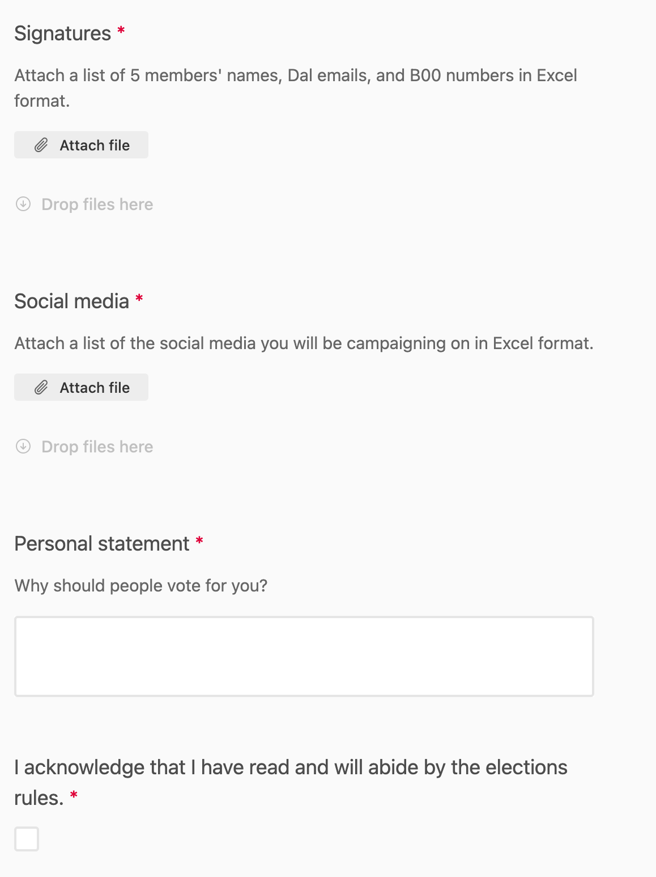
Nomination form template (cont’d)
Signatures: Ensures that candidates have some support within the Society. Signatures are from Society members.
Social media handles are important for monitoring.
Personal statements can be distributed to the membership though Society channels.
Make sure people read the rules!
Basic information: Helps with ensuring candidate eligibility

Slide 20
Nominations: Selection and communications
After the deadline for submissions is over, the Elections Officer should go over them to ensure validity (e.g., that the candidate is a member of the Society, that they belong in the group they are seeking to represent, etc.). Candidates who do not meet the criteria should be contacted by the EO to explain the situation and avoid frustration.
Once decided, nominees should be contacted as confirmation they are officially running in the elections, to ensure that they receive any necessary training, and that they know and understand election rules. This is crucial to avoid infractions.

Slide 21
Tips for the campaign period
Personal candidate social media profiles should be monitored by the EO on a regular basis to ensure election rules are being followed.
Complaints should be dealt with in a timely manner to avoid frustration.
If applicable (aka for Levy Societies and General Interest Societies with no membership limitations), Societies can tag the DSU on socials (@dalstudentunion on IG) to have posts shared.

Slide 22
Elections quorum
What is quorum?
Quorum is the minimum number of people needed to conduct business (aka make decisions) in governance settings.
It is usually framed as a fixed number or as a percentage of the membership.
Why is quorum needed in elections?
Quorum is used as a metric to ensure the voting process is valid and was made with enough consultation from the membership.
How is quorum for elections decided?
There is no set standard for how many people are enough for quorum. Many societies choose 50% of the membership, others a fixed number (e.g., 25 attendees for in-person voting).
The size of the Society should be considered. 5 people for a 300-person Society is certainly not enough; 90% is likely unachievable.
As always, quorum is something decided on by membership consensus through the Society’s Constitution.
How is quorum achieved?
For in-person voting, enough members should attend to meet quorum. The meeting time and date should be promoted well in advance.
For digital voting, promotional efforts to voters are important, and ensuring the form is distributed and accessible.

Slide 23
Voting security
What is voting security?
The certainty that only eligible voters are submitting ballots in an election.
The knowledge that only the right people know ballot contents at a given time.
Why is voting security important?
Voting security issues are one of the most common Society complaints received by the DSU Society Review Committee.
Compromised voting security results in mistrust in the democratic process and in election results. This can lead to loss of membership and poor intra-Society dynamics.
How is voting security achieved?
Depends on your membership! These are some ideas you can employ with varying degrees of success.
In-person voting is less susceptible to voter fraud, as long as proxy rules are clearly followed. Usually voting security concerns arise with online voting.

Slide 24
Voting security compromise examples
Ballot information is being shared with people who aren’t the Elections Officer or their designate.
Confidentiality is integral for the voting process.
Ballot anonymity is compromised.
No one should be able to connect a vote to a name, ideally not even the Elections Officer. Anonymity allows voters to voice their opinion without fear of consequences (e.g., social relationships being threatened).
People acting as voting proxies without permission.
Some proof that a proxy has been authorized to make decisions on another member’s behalf is ideal.
Voting forms leaking to non-members.
Only Society members should have access.
There should be a way to tell which people are not authorized to vote and throw these ballots out.

Slide 25
Online voting security methods
Levy Societies and General Interest Societies with no membership criteria:
Using a Microsoft Form restricted to only Dal emails will ensure that only current students can submit a ballot.
Note that King’s students also have Dal emails, so this option can accommodate them if applicable.
Faculty Societies:
Some Faculty Societies partner with their Faculty to ensure only members’ votes are counted. Methods include:
Creating a Brightspace website only accessible by students in the Faculty (Commerce Society).
Asking a Student Engagement Manager to verify which B00 numbers belong to current students in the Faculty (Computer Science Society).
Residence Councils:
Residence Council Societies can talk to their respective RLM for support with elections (see Faculty Societies).
Constituent Societies:
If reaching out to all department students, you can consider working with your department or Faculty. If membership is more restricted and better defined, see below.
General Interest Societies with a restricted membership:
To protect voter anonymity, you can assign voter keys to members. The EO can share each voter key with its voter to submit with their ballot. Someone who doesn’t know which voter key matches with each student can count the ballots and ensure only valid voter key ballots count.
This method can be cumbersome for more than 30-35 members, but as long as there is a defined list of members it should work fine.
There are websites that can be used for free (up until a certain number of voters) that employ the same method, but really any form would work (Google, Microsoft, Airtable, etc.)

Slide 26
Voting security: Voter key method scenario
The Elections Officer of the Unicorn Conservation Society and their Deputy are preparing for the election voting period.
Based on the membership criteria outlined in the UCS Constitution, they create a list of 45 members in good standing. This list is published to the membership.
For each member, the EO assigns one voter key (e.g., Sally Uno – ‘mane’, Mike Michaelson - ‘horn’, Sammy Sampson – ‘hoof’, etc.).
The DEO is given a list of voter keys, without the corresponding names.
Each member receives their own voter key from the EO.
The DEO creates the nomination form and adds a required question: “What is the password?”
Non-members should not be able to answer this question, but voters can!
The DEO only counts ballots with legitimate voter keys, but still doesn’t know who voted for whom. Resulting ballots do not exceed 45.
The EO doesn’t look at the ballots, so they don’t know who voted for whom, but is confident the results are legitimate when presenting them to the membership.

Slide 27
Voting period, results, and transition
Voting periods for online voting usually last a couple of days, however if quorum isn’t met in that timeframe, the EO can opt to extend for an additional couple of days.
Similarly, if an in-person voting meeting doesn’t meet quorum, the meeting should be rescheduled ASAP.
Once results are in, they need to be announced to the membership. Number of votes and similar information can be released if the EO wishes, but it’s not necessary.
Transition efforts should begin ideally immediately after the announcement. Transition reports should be complete at this point. There should be a specific date at which the new executive will take over.
For unfilled seats, a run-off election can be scheduled soon after the main one, or they can be filled at a by-election a few months later.
Click the icon for a link to the DSU transition guide!

Slide 28
Subsequent elections
Run-off elections:
Done shortly after main elections are done for positions that haven’t been filled.
Follow the same procedure as the main elections process but the timeline may be reduced to have positions filled ASAP.
By-elections:
Usually reserved for the next semester.
Applicable for Societies that appoint interims.
E.g., if the Comms Director position remains vacant, someone is appointed to fill the position between the main election and the by-election.
This way the Society doesn’t go without a crucial position for its operations.
Often reserved for positions that can’t be filled the same time as everyone else.
E.g., Year-rep positions are sometimes best filled by students currently in their year who you know will be active.

